Slide 1
Front-End Fun with SASS and Coffee!
NDC Oslo 2015
Dylan Beattie @dylanbeattie
www.dylanbeattie.net dylan@dylanbeattie.net

Slide 2
Agenda
Background
SASS TypeScript CoffeeScript
Tooling and
ASP.NET

Slide 3
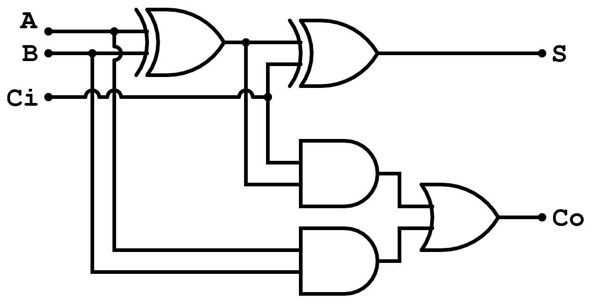
(Full adder image from http://www.ccs.neu.edu/course/cs1800/15S/videos.html)

Slide 4
Abstractions All The Way Down
Windows
Linux
MacOS
C
Assembler
01001000 01000101 01001100 01001100 01001111 01001111 01010011 01001100 01001111 00100001

Slide 5







Abstractions All The Way Down
Windows
Linux
MacOS
C
Assembler
01001000 01000101 01001100 01001100 01001111 01001111 01010011 01001100 01001111 00100001

Slide 6





Abstractions All The Way Down
MacOS
Not Our Problem.
Windows
Linux
C
Assembler
01001000 01000101 01001100 01001100 01001111 01001111 01010011 01001100 01001111 00100001

Slide 7
“Write Once, Run Anywhere”
HTML
JS
CSS

Slide 8
A long time ago, at a university far, far away…
http://www.dylanbeattie.net/starwars/

Slide 9
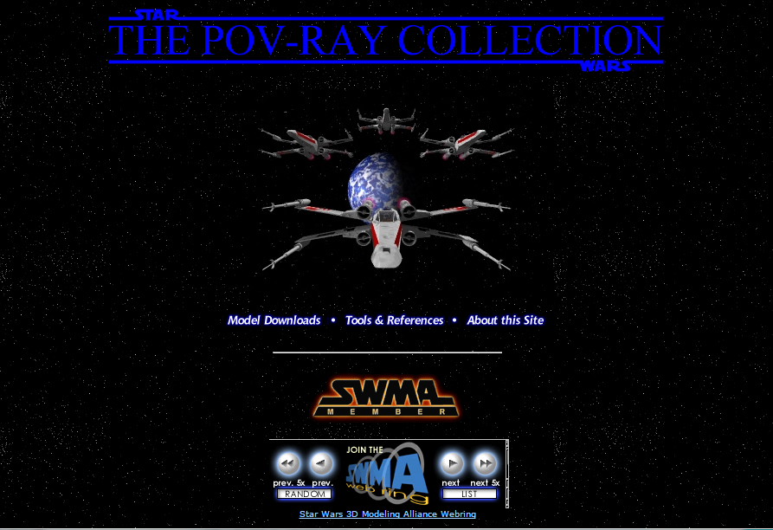

Slide 10
“…the Machine Code of the Web… ”
HTML
JS
CSS

Slide 11
…but this is 2015!
Nobody writes machine code
any more!
(unless they want to.)

Slide 12
People write programs. Programs write pages.
Server-Side
ASP.NET NodeJS
Ruby
PHP
Python
Client-Side
Knockout
Backbone
Angular
Ember
CanJS

Slide 13
People write programs. Programs write pages.
Server-Side
ASP.NET NodeJS
Ruby
PHP
Python
Client-Side
Knockout
Backbone
Angular
Ember
CanJS
HTML

Slide 14
‘Inside-out’ CSS
h1, h2, h4, em, header#strapline { color: #003366;
}
h1, h2, nav, menu {
font-family: Kayak;
}
h1, h2, menu {
font-weight: bold;
}

Slide 15
People write programs. Programs write pages scripts and stylesheets
?
?
CSS
JS
?
?
?
?

Slide 16
People write programs. Programs write pages scripts and stylesheets
ASP.NET?
?
CSS
JS
?
PHP?
?
Ruby?

Slide 17
Write your CSS in ASP.NET
http://sassdemo/asp_net_css_demo.html

Slide 18

Syntactically Awesome Style Sheets

Slide 19
A Preprocessor for CSS
SASS
Source
File
SASS Preprocessor
Plain
Old
CSS

Slide 20
"Sassy CSS" vs SASS
"Sassy CSS" (.scss)
SASS (.sass)
A superset of CSS3
All valid CSS3 files are also valid SCSS files
Older block-based syntax
body {
→ font: 100% $font-stack;
→ color: $primary-color;
}
body
→ font: 100% $font-stack;
→ color: $primary-color;
(I use this one because I like it better.)

Slide 21
Variables
Colors
$corporate-green: #339933;
Strings
$primary-font: “Zapf Chancery”;
$secondary-font: Kayak;
Measurements
$page-width: 960px;

Slide 22
Operators and Expressions
$text-width: 600px;
$margin: 20px;
$page-width: $text-width + (2 * $margin);

Slide 23
Color Arithmetic
$brandColor: #336699;
$lightColor: lighten($headingColor, 25%)
$darkColor: darken($headingColor, 25%);
$richColor: saturate($headingColor, 25%);
$thinColor: desaturate($headingColor, 25%);

Slide 24
Nesting - Rules
header {
a { color: $link-color; text-decoration: none;
}
h1 { color: $site-color; }
}

Slide 25
Nesting - Properties
header {
font {
family: Kayak;
size: 1.2em;
weight: bold;
}
}
header {
font-family: Kayak; font-size: 1.2em;
font-weight: bold;
}

Slide 26
Partials and Imports
Server-side includes for CSS
Partial filenames start with an underscore
_colorscheme.scss
And then you import them:
import(colorscheme)
(underscore and file extension not required)

Slide 27
Mixins
@mixin border-radius($radius) { -webkit-border-radius: $radius; -moz-border-radius: $radius; -ms-border-radius: $radius; border-radius: $radius; } .box { @include border-radius(10px); }

Slide 28
Inheritance and @extends
.message { border: 1px solid #ccc; padding: 10px; color: #333;
}
.success { @extend .message; border-color: green; }
.error { @extend .message; border-color: red; }

Slide 29
A Live Demo Of SASS

Slide 30
"I'm working on a script..."

Slide 31
There are over 400 languages that "compile to JavaScript"
https://github.com/jashkenas/coffeescript/wiki/List-of-languages-that-compile-to-JS

Slide 32

$HODOR: hhodor? Hodor!? Hodor!? oHooodorrhodor orHodor!? d = HoDoRHoDoR () { hodor.hod('Hhodor? Hodor!? Hodor!?' + 'o HODOR!? orHodor!? d!'); }; hhodor? Hodor!? Hodor!? oHooodorrhodor orHodor!? d();

Slide 33
CoffeeScript
"JavaScript has always had a gorgeous heart. CoffeeScript is an attempt to expose the good parts of JavaScript in a simple way."
(gorgeous)

Slide 34
TypeScript
"... a typed superset of JavaScript that compiles to plain JavaScript."

Slide 35
function greet(name) {
return("Hello " + name);
}
greet("NDC Oslo");
greet = name -> "Hello " + name;
greet("NDC Oslo")
class Greeter {
constructor() { }
greet(name : string) {
return "Hello " + name;
}
};
var greeter = new Greeter("NDC Oslo");
greeter.greet();

Slide 36
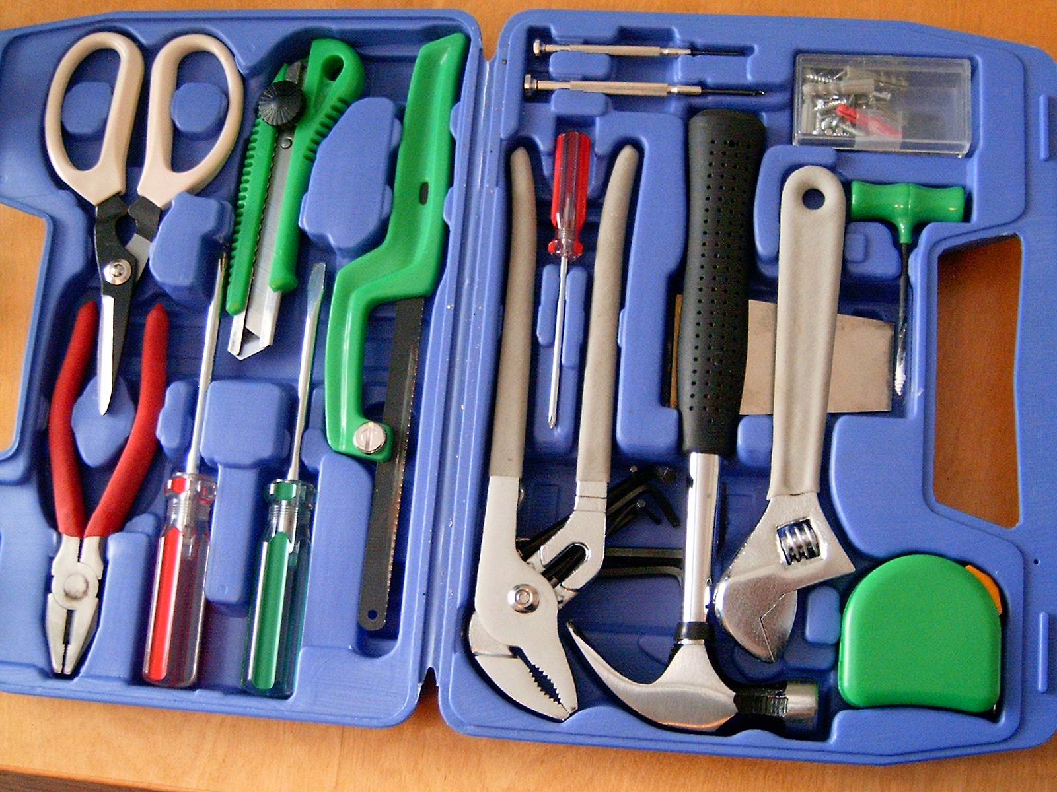

Slide 37
The SASS Build Chain
SASS
Source
File
SASS Preprocessor
Plain
Old
CSS

Slide 38

The SASS Build Chain
SASS
Source
File
Plain
Old
CSS

Slide 39
Visual Studio Support
VS2013 has editor support for SASS, TypeScript and CoffeeScript...
but doesn't compile them.

Slide 40
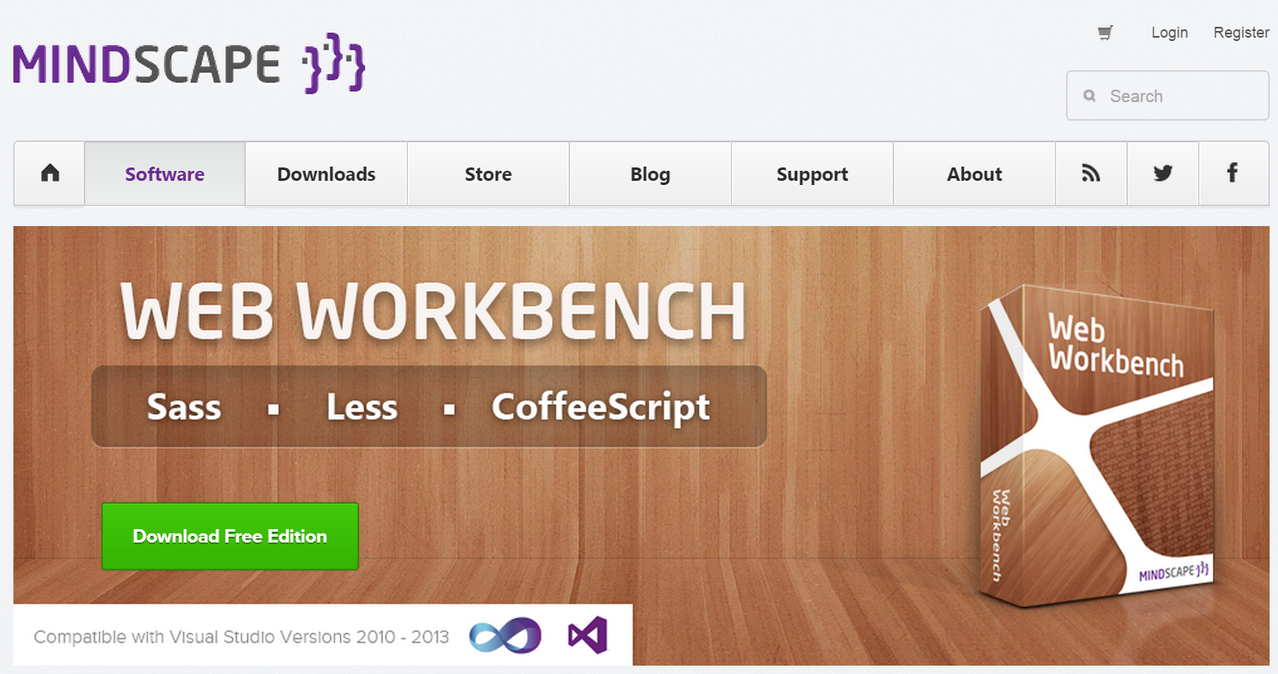
Mindscape Web Workbench
http://www.mindscapehq.com/

Slide 41

The TypeScript Compiler
INSTALL: npm install –g typescript
COMPILE: tsc helloworld.ts

Slide 42
The CoffeeScript Compiler
INSTALL: npm install –g coffee-script
COMPILE: coffee --compile --output css/ src/

Slide 43




...but...

Slide 44
Bundle Transformer
NuGet:
PM> Install-Package BundleTransformer.SassAndScss
PM> Install-Package BundleTransformer.CoffeeScript
PM> Install-Package BundleTransformer.TypeScript

Slide 45
The ASP.NET Request Lifecycle
SASS
Source
File
IronRuby
(really!)
Plain
Old
CSS

Slide 46
Live Demo
Debug vs Release Mode
Bundle Optimisation
Skylight

Slide 47
In conclusion
HTML, JS, CSS: the machine language of the web
You don't have to write them by hand
BundleTransformer makes SASS, CoffeeScript and TypeScript on ASP.NET really easy

Slide 48
Questions? Feedback?
Code for today's demo:
https://github.com/dylanbeattie/ndc-oslo-2015
Questions?
dylan@dylanbeattie.net
@dylanbeattie

Slide 49
Thank you!

